Slide 1
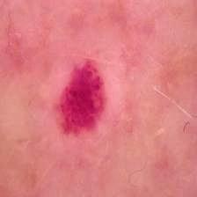
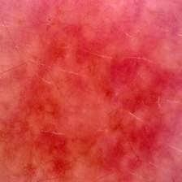
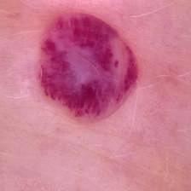
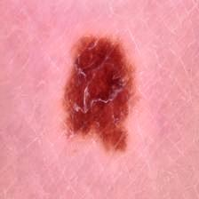
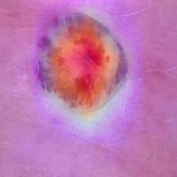
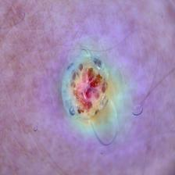
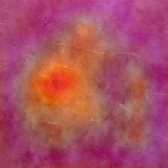
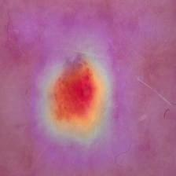
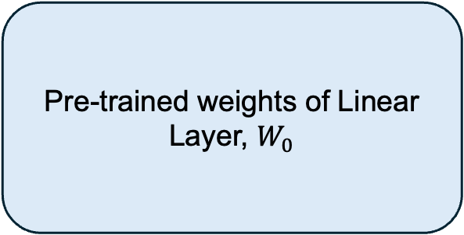
HAM10000 Dataset
Patient level split
Augmentation
Preprocess
Training 80%
Photometric
Geometric
Resize Image
Hair removal
Validation 10%
Illumination + CLAHE
Testing 10%
Normalization
CutMix + Mixup Aug.
Classified Output
Classification Head
mel
nv
vasc
CBAM
BLock
Xception Model Block
akiec
bcc
bkl
df
Global Max Pooling
Dropout
Dense Layer
L1 & L2 Regularization
SoftMax
GradCam++ Image
Dataset (347 IMG)
Proposed Dataset
Original image
Grad-CAM++ heatmap image
Predicted class
Morphological description of the image
Expert’s Annotation
with textual descriptions
of morphological features
Input Features
Med-Gemma-4B Model
LoRA Adapter
Pre-trained weights of Linear Layer, $W_{0}$
A
r
B
Output Features/ Explanation of the Classifier Decision

Slide 2
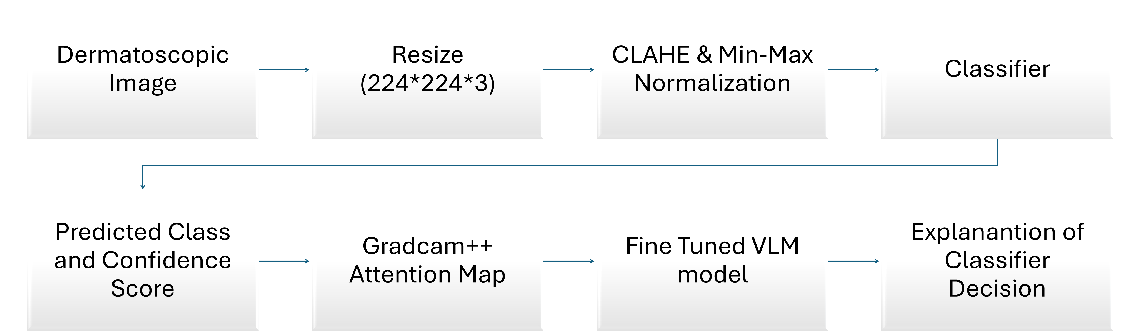
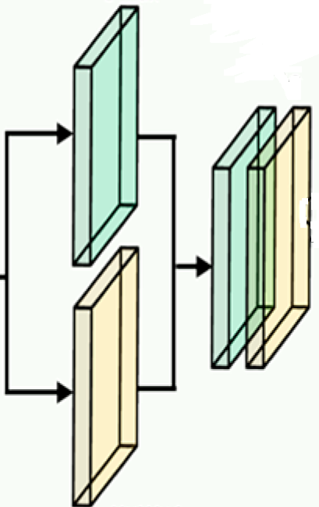
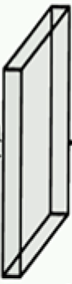


Entry Flow
3×3 SCONV
3×3 SCONV
3×3 CONV
3×3 CONV
ReLU
MaxPool
3×3 SCONV
3×3 SCONV
3×3 SCONV
ReLU
ReLU
ReLU
ReLU
MaxPool
ReLU
3×3 SCONV
Preprocessed Image
Input: 299×299×3
ReLU
MaxPool
1×1
CONV
1×1
CONV
1×1
CONV
ReLU
Xception Model
3×3 SCONV
3×3 SCONV
MaxPool
ReLU
ReLU
3×3 SCONV
ReLU
ReLU
3×3 SCONV
3×3 SCONV
ReLU
(10, 10, 2048) feature map
3×3 SCONV
Middle Flow (Repeat 8 Times)
ReLU
1×1 CONV
3×3 SCONV
Exit Flow
Feature: H×W×C
Global max pooling
C/16
C
Global max pooling
Max pooling
H×W×1
1×1×C
Concatenation
H×W×2
H×W×1
conv
7×7
H×W×C
Global avg pooling
Global avg pooling
CBAM Layer
1×1×C
Convolutional
Feature H×W×1
Shared Dense
Layer
Element-wise Addition
Element-wise Product
Avg pooling H×W×1
Sigmoid Activation
Softmax Layer
ReLU
Classified Output with
Confidence Score
….
Fully Connected Layer
….
Dropout = 0.4
Global avg pooling
$n_{c}$ unit
$$128 unit$$
L1=1e-5, L2=1e-3
Dermatoscopic Image
Resize (224*224*3)
CLAHE & Min-Max Normalization
Classifier
Predicted Class and Confidence Score
Gradcam++ Attention Map
Fine Tuned VLM model
Explanantion of Classifier Decision

